Slide 1
Pattern Classification All materials in these slides were taken from Pattern Classification (2nd ed) by R. O. Duda, P. E. Hart and D. G. Stork, John Wiley & Sons, 2000 with the permission of the authors and the publisher

Slide 2
Chapter 3: Maximum-Likelihood & Bayesian Parameter Estimation (part 1)
Introduction
Maximum-Likelihood Estimation
Example of a Specific Case
The Gaussian Case: unknown μ and σ
Bias
Appendix: ML Problem Statement

Slide 3
Introduction
Data availability in a Bayesian framework
We could design an optimal classifier if we knew:
P(ω_{i}) (priors)
P(x | ω_{i}) (class-conditional densities)
Unfortunately, we rarely have this complete information!
Design a classifier from a training sample
No problem with prior estimation
Samples are often too small for class-conditional estimation (large dimension of feature space!)

Slide 4
A priori information about the problem
Normality of P(x | ω_{i})
P(x | ω_{i}) ~ N( μ_{i}, Σ_{i})
Characterized by 2 parameters
Estimation techniques
Maximum-Likelihood (ML) and the Bayesian estimations
Results are nearly identical, but the approaches are different

Slide 5
Parameters in ML estimation are fixed but unknown!
Best parameters are obtained by maximizing the probability of obtaining the samples observed
Bayesian methods view the parameters as random variables having some known distribution
In either approach, we use P(ω_{i} | x) for our classification rule!

Slide 6
Maximum-Likelihood Estimation
Has good convergence properties as the sample size increases
Simpler than any other alternative techniques
General principle
Assume we have c classes and
P(x | ω_{j}) ~ N( μ_{j}, Σ_{j})
P(x | ω_{j}) ≡ P (x | ω_{j}, θ_{j}) where:

Slide 7
Use the information provided by the training samples to estimate
θ = (θ₁, θ₂, …, θ_{c}), each θ_{i} (i = 1, 2, …, c) is associated with each category
Suppose that D contains n samples, x₁, x₂,…, x_{n}
ML estimate of θ is, by definition the value that maximizes P(D | θ)
“It is the value of θ that best agrees with the actually observed training sample”

Slide 8
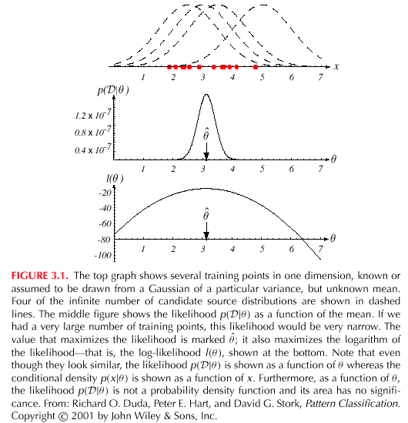

Slide 9
Optimal estimation
Let θ = (θ₁, θ₂, …, θ_{p})^{t} and let ∇_{θ} be the gradient operator
We define l(θ) as the log-likelihood function
l(θ) = ln P(D | θ)
New problem statement:
determine θ that maximizes the log-likelihood

Slide 10
Set of necessary conditions for an optimum is:
∇_{θ}l = 0

Slide 11
Example of a specific case: unknown μ
P(x_{i} | μ) ~ N(μ, Σ)
(Samples are drawn from a multivariate normal population)
θ = μ therefore:
The ML estimate for μ must satisfy:

Slide 12
Multiplying by Σ and rearranging, we obtain:
Just the arithmetic average of the samples of the training samples!
Conclusion:
If P(x_{k} | ω_{j}) (j = 1, 2, …, c) is supposed to be Gaussian in a d-dimensional feature space; then we can estimate the vector
θ = (θ₁, θ₂, …, θ_{c})^{t} and perform an optimal classification!

Slide 13
ML Estimation:
Gaussian Case: unknown μ and σ θ = (θ₁, θ₂) = (μ, σ²)

Slide 14
Summation:
Combining (1) and (2), one obtains:

Slide 15
Bias
ML estimate for σ² is biased
An elementary unbiased estimator for Σ is:

Slide 16
Appendix: ML Problem Statement
Let D = {x₁, x₂, …, x_{n}}
P(x₁,…, x_{n} | θ) = Π^{1,n}P(x_{k} | θ); |D| = n
Our goal is to determine (value of θ that makes this sample the most representative!)

Slide 17
|D| = n
.
.
.
.
x₂
x₁
.
.
x_{n}
N(μ_{j}, Σ_{j}) = P(x_{j}, ω₁)
P(x_{j} | ω₁)
P(x_{j} | ω_{k})
D₁
x₁₁
.
.
.
.
x₁₀
.
D_{k}
D_{c}
x₈
.
.
.
x₂₀
.
.
x₁
x₉
.
.

Slide 18
θ = (θ₁, θ₂, …, θ_{c})
Problem: find such that:

